Slide 1

Unit – 5 Multiple integral
Mathematics – I (M-I)
GTU # 3110014
Prof. Kartikraj Dhamsaniya
Humanities & Science Department
kartikraj.dhamsaniya@darshan.ac.in
972 41 42 400

Slide 2
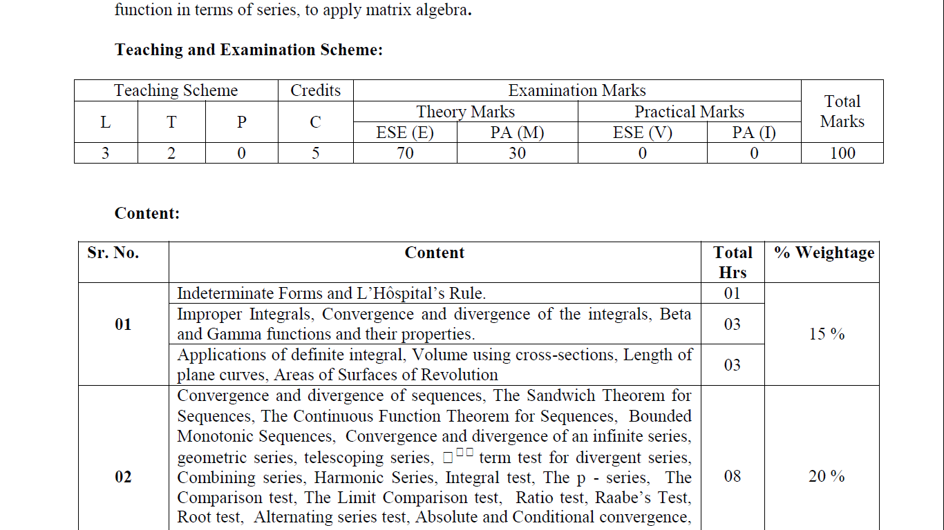
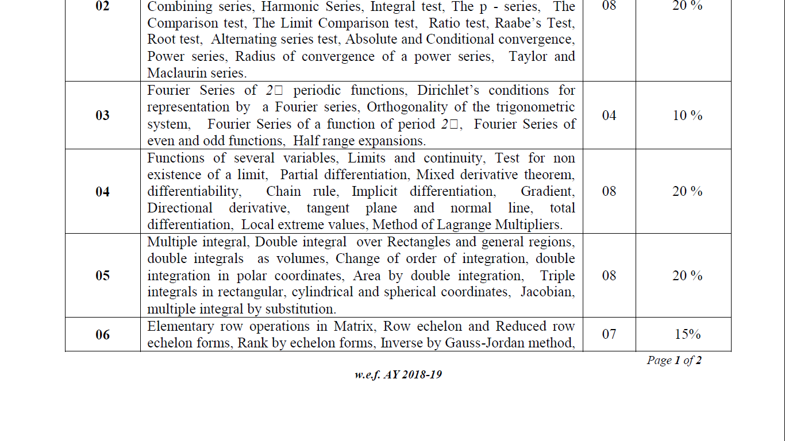
Unit 5 Multiple Integral
Double integral over Rectangles and general regions
Double integrals as volumes
Change of order of integration
Double integration in polar coordinates
Area by double integration
Triple integrals in rectangular
Cylindrical and spherical coordinates
Jacobian
Multiple integral by substitution

Slide 3
METHOD – 6 : D.I. OVER GENERAL REGION IN POLAR COORDINATES(1)
METHOD – 5 : D.I. BY CHANGE OF ORDER OF INTEGRATION(3)
METHOD – 13 : D.I. BY CHANGE OF VARIABLE IN CARTESIAN COORDINATES
METHOD – 14 : D.I. BY CHANGE OF VARIABLE IN POLAR COORDINATES(2)
METHOD – 7 : AREA BY DOUBLE INTEGRATION IN CARTESIAN COORDINATES(1)
METHOD – 8 : AREA BY DOUBLE INTEGRATION IN POLAR COORDINATES
METHOD – 4 : DOUBLE INTEGRALS AS VOLUMES(1)
METHOD – 9 : T.I. OVER GENERAL REGION IN CARTESIAN COORDINATES
METHOD – 10 : T.I. OVER GENERAL REGION IN CYLINDRICAL COORDINATES
METHOD – 11 : T.I. OVER GENERAL REGION IN SPHERICAL COORDINATES(1)

Slide 4
Outline
Looping
D.I. over general region – PC
D.I. by Change of Order of integration
D.I. by Change of Variable of integration – CC & PC
Area by D.I. – CC & PC
Volume by D.I.
T.I. over General Region

Slide 5
D.I. over general region – PC (Method-6)

Slide 6
Remark
In Cartesian coordinate, we have x-axis & y-axis (in two dimension).
While in polar coordinate, we have r-axis & θ-axis.
Y- axis
θ- axis
θ
X- axis
r- axis

Slide 7
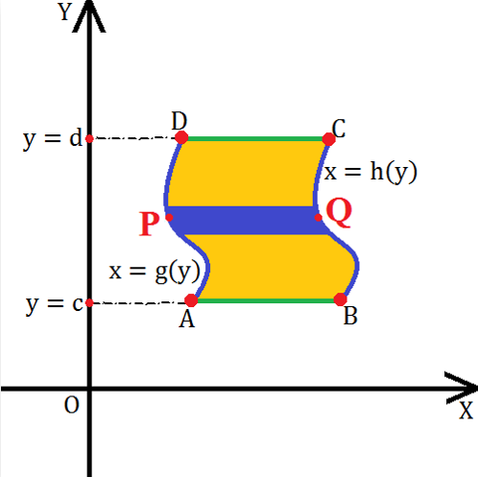
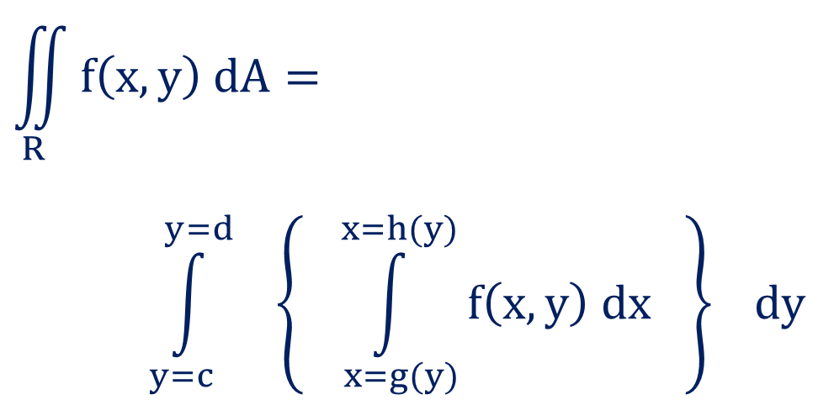
Strip parallel to X-axis
So if we take a strip parallel to X-axis then
we have to integrate given function
first with respect to variable x and
then variable y.
$$\iint_{R}^{ }{f\left(x,y\right) dA}=$$
$$\int_{y=c}^{y=d}{ \left\{\int_{ x=g(y)}^{x=h(y)}{f\left(x,y\right) dx }\right\}} dy$$

Slide 8
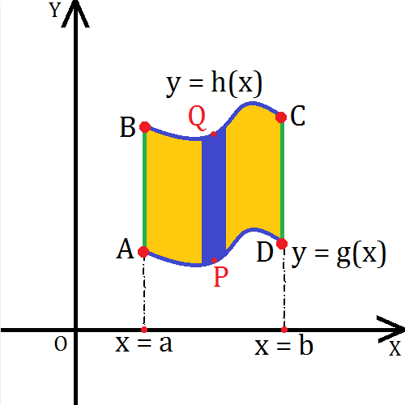

Strip parallel to Y-axis
So if we take a strip parallel to Y-axis then
we have to integrate given function
first with respect to variable y and
then variable x.
$$\iint_{R}^{ }{f\left(x,y\right) dA}=$$
$$\int_{x=a}^{x=b}{ \left\{\int_{ y=g(x)}^{y=h(x)}{f\left(x,y\right) dy }\right\}} dx$$

Slide 9
Procedure to find double integral over General Region - PC
If we want to find the value of given double integral over general region in PC, we will follow following steps:
Draw all the curves and identify required region.
Take the strip from origin within the region.
If required then divide the region into two parts.
Find limits of inner integral from the strip i.e. $r_{1}$ & $r_{2}$
Find limits of inner integral from the strip i.e. r_1 & r_2
Find limits of outer integral from angle i.e. $θ_{1}$ & $θ_{2}$
Find limits of outer integral from angle i.e. θ_1 & θ_2
Calculate the example as the example of double integrals.

Slide 10
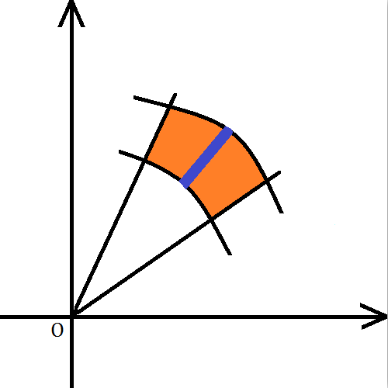
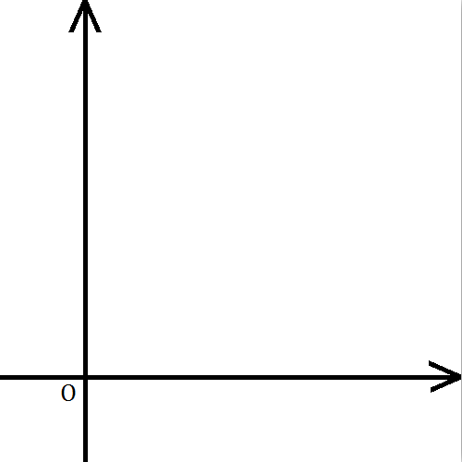
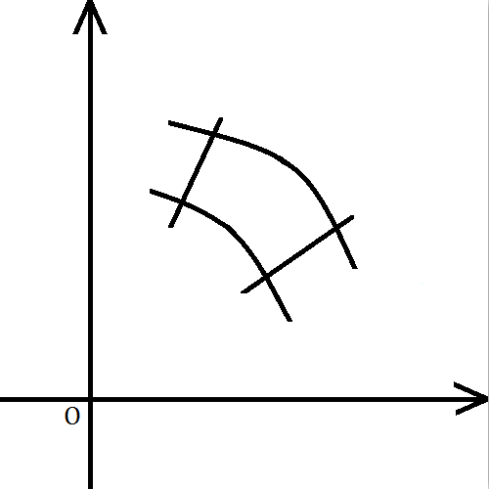
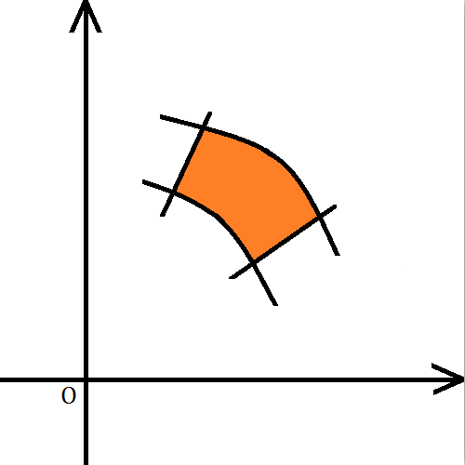
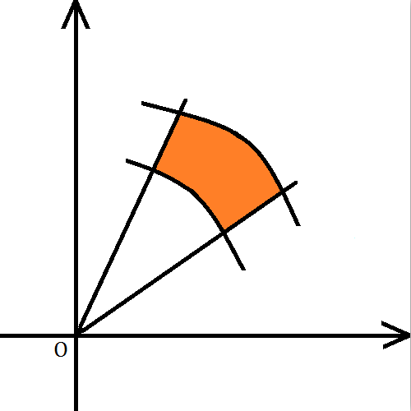
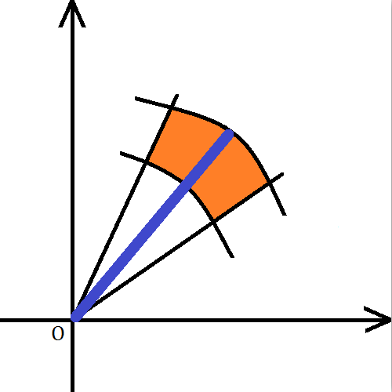
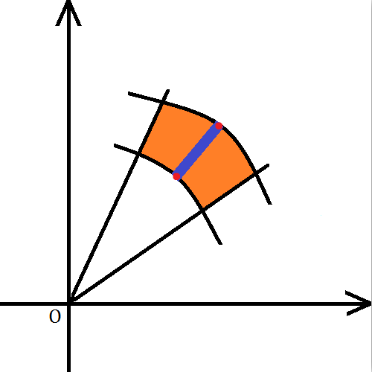

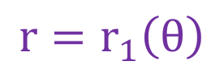
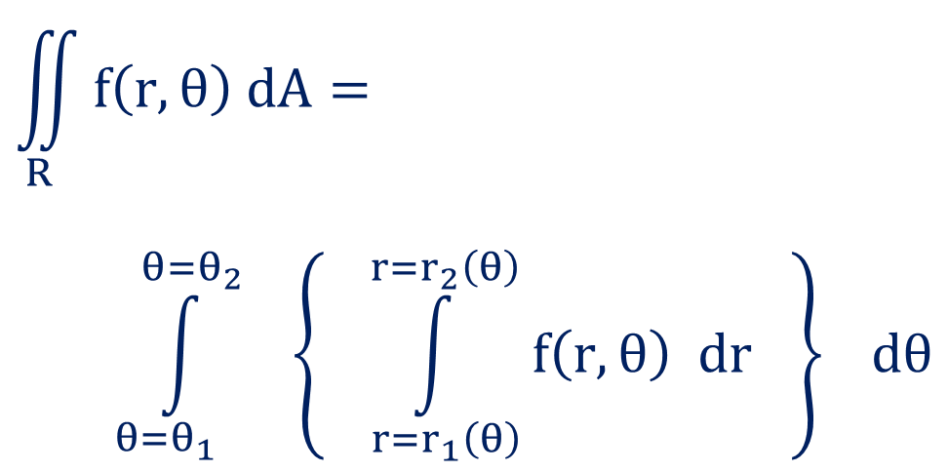
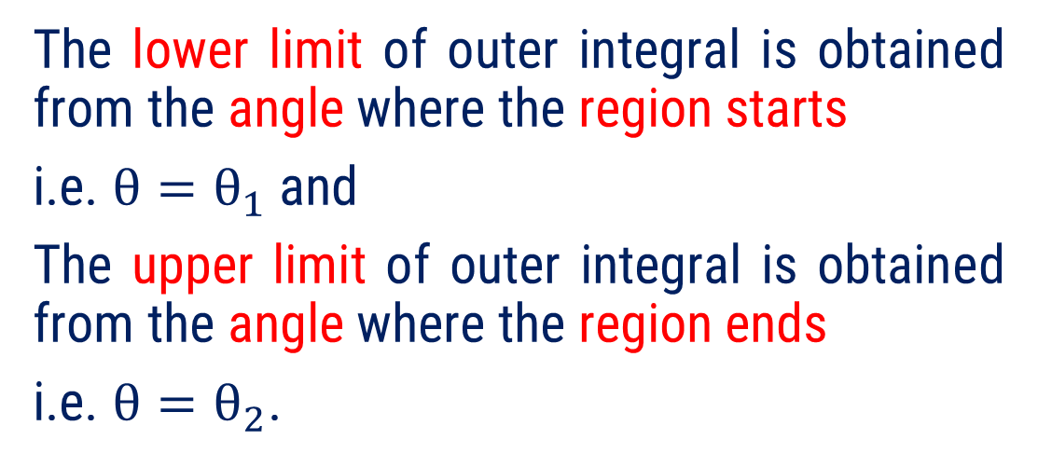
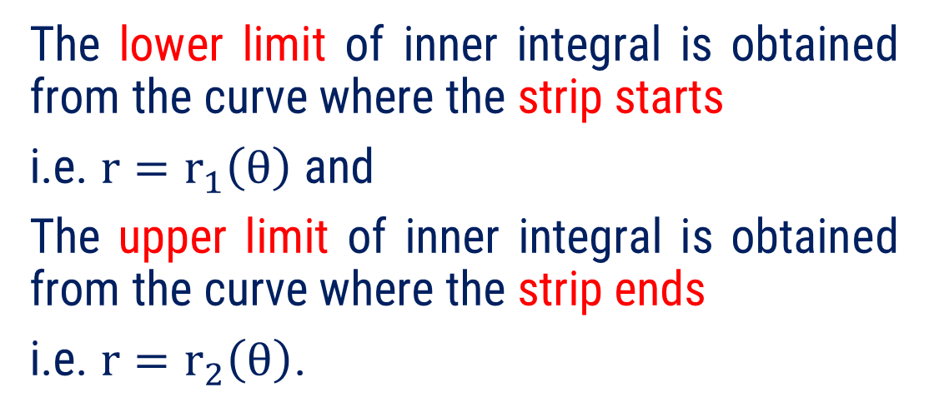
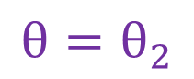
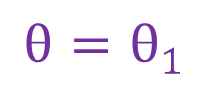
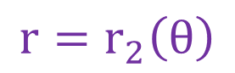
Strip
$$\iint_{R}^{ }{f\left(r,θ\right) dA}=$$
$$\int_{θ=θ_{1} }^{θ=θ_{2}}{ \left\{\int_{ r=r_{1}\left(θ\right)}^{r=r_{2}\left(θ\right)}{f\left(r,θ\right) dr }\right\}} dθ$$
$$θ=θ_{2}$$
$$θ=θ_{1}$$
The lower limit of outer integral is obtained from the angle where the region starts
i.e. $θ=θ_{1}$ and
The upper limit of outer integral is obtained from the angle where the region ends
i.e. $θ=θ_{2}$.
$$r=r_{2}\left(θ\right)$$
The lower limit of inner integral is obtained from the curve where the strip starts
i.e. $r=r_{1}\left(θ\right)$ and
The upper limit of inner integral is obtained from the curve where the strip ends
i.e. $r=r_{2}\left(θ\right)$.
$$r=r_{1}\left(θ\right)$$

Slide 11
Few Important Curves in PC
Circle, Cardioid, Lemniscates

Slide 12
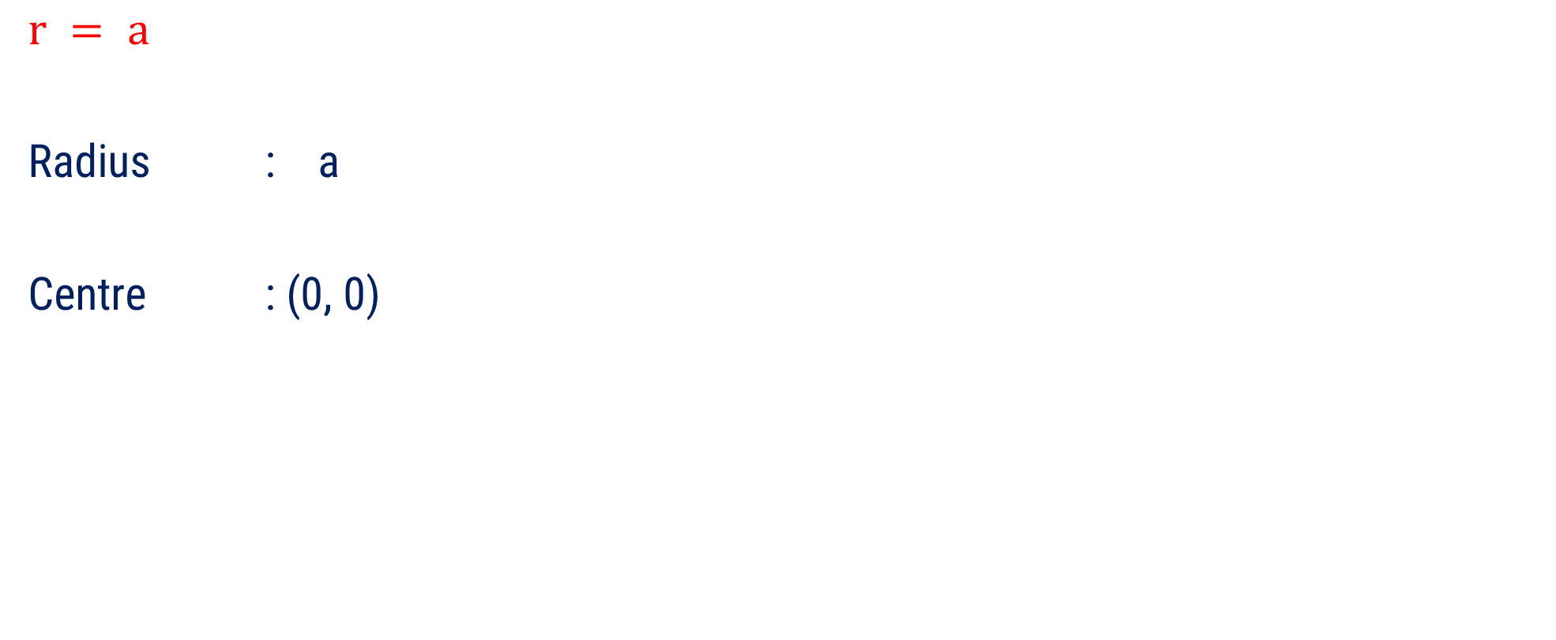
Equation of Circle
$$r = a$$
Radius : a
Centre : (0, 0)
r- axis
a

Slide 13
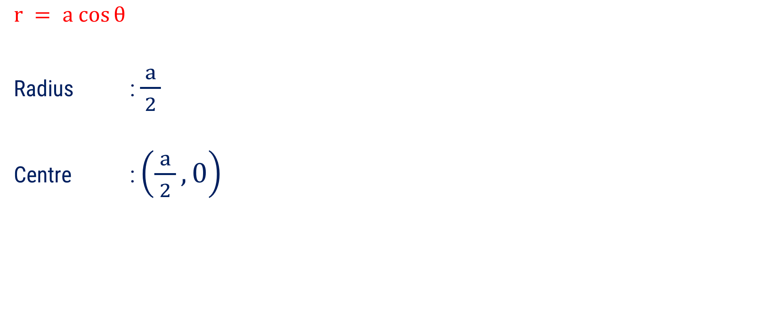
Equation of Circle
$$r = a cos⁡θ$$
Radius : $\frac{ a }{2}$
Centre : $\left(\frac{a}{ 2 }, 0\right)$
r- axis
a

Slide 14
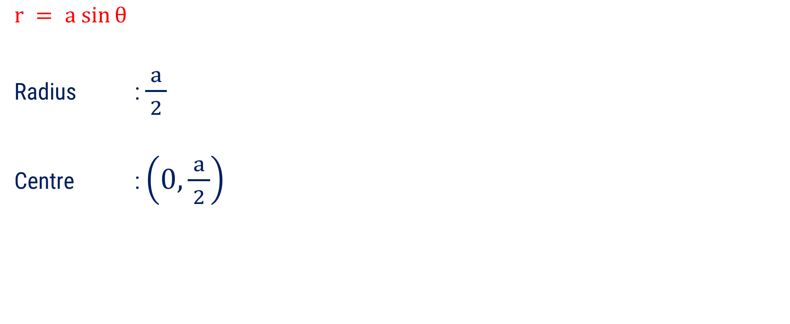
Equation of Circle
$$r = a sin⁡θ$$
Radius : $\frac{ a }{2}$
Centre : $\left(0, \frac{a}{ 2 }\right)$
a
r- axis

Slide 15
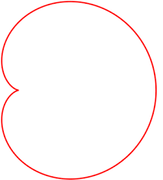
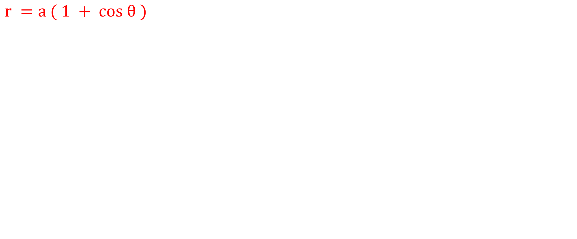
Equation of Cardioid
$$r =a ( 1 + cos θ )$$
a
r- axis
2a

Slide 16

Equation of Cardioid
$$r =a ( 1 +sin θ )$$
2a
a
r- axis

Slide 17
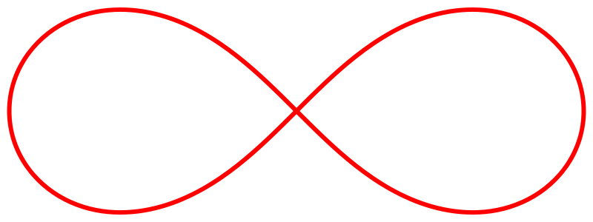

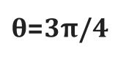
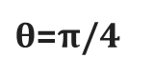
Equation of Lemniscates
$$r^{2}=a^{2} cos⁡2θ$$
$θ$=3π/4
$θ$=π/4
r- axis
a

Slide 18

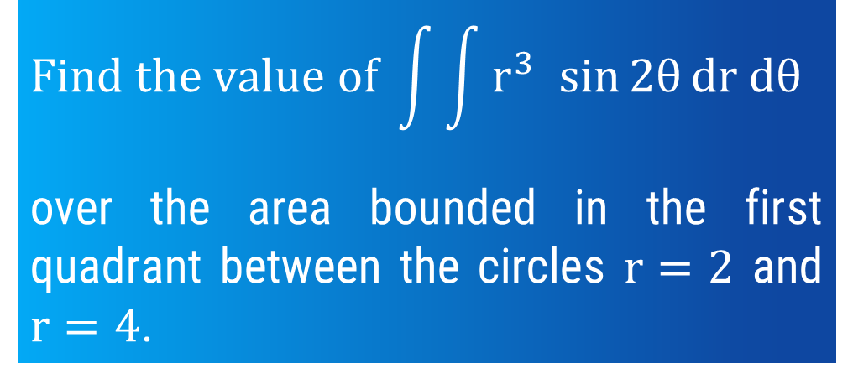
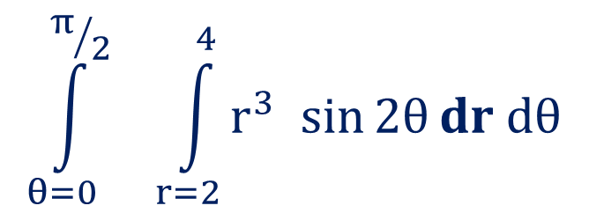
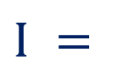
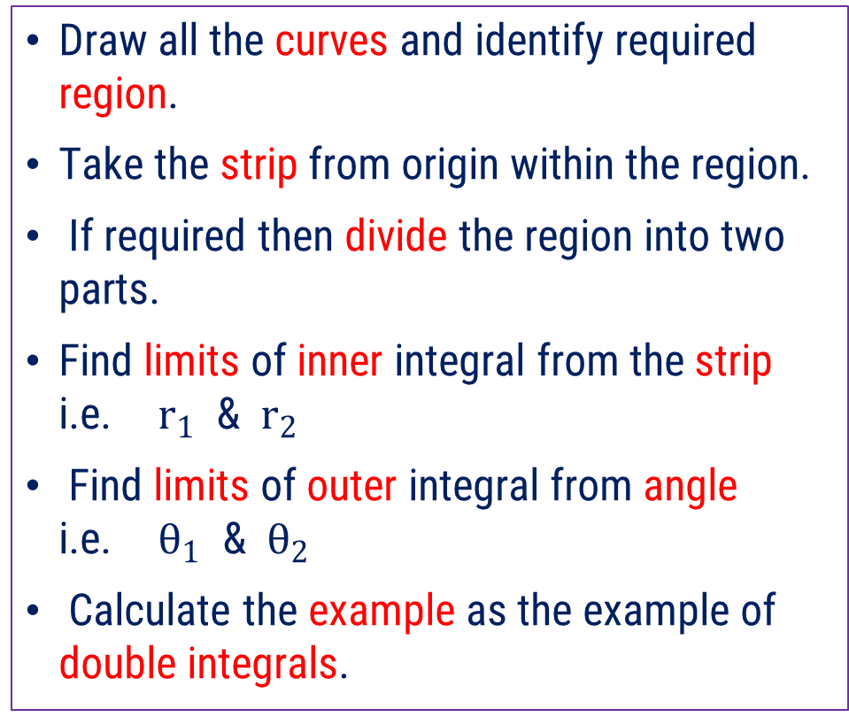
Method 6 $⇒$ Example – 1
$$Find the value of \int{\int{r^{3} sin⁡2θ}}dr dθ$$
over the area bounded in the first quadrant between the circles $r=2$ and $r=4$.
Draw all the curves and identify required region.
Take the strip from origin within the region.
If required then divide the region into two parts.
Find limits of inner integral from the strip i.e. $r_{1}$ & $r_{2}$
Find limits of outer integral from angle i.e. $θ_{1}$ & $θ_{2}$
Calculate the example as the example of double integrals.
Required region
r- axis
Solution:
4
2
r = 2
r = 4
$$\int_{θ=0}^{π/2}{ \int_{r=2}^{4}{r^{3} sin⁡2θ}}dr dθ$$
$$I =$$
……

Slide 19
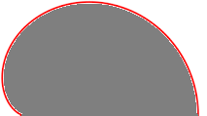
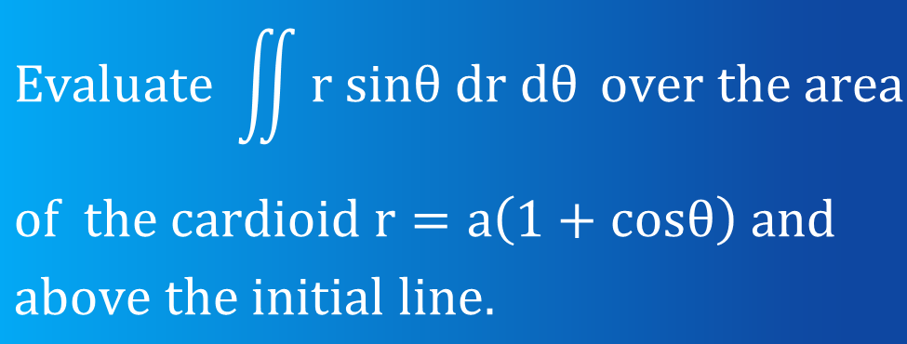
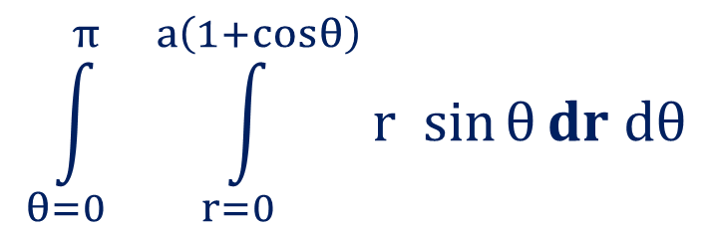
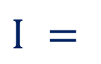
Method 6 $⇒$ Example – 4
$$Evaluate \iint{r sinθ dr dθ }over the area$$
$$of the cardioid r=a\left(1+cosθ\right) and$$
$$above the initial line.$$
Draw all the curves and identify required region.
Take the strip from origin within the region.
If required then divide the region into two parts.
Find limits of inner integral from the strip i.e. $r_{1}$ & $r_{2}$
Find limits of outer integral from angle i.e. $θ_{1}$ & $θ_{2}$
Calculate the example as the example of double integrals.
Region above the initial line
a
Solution:
2a
r- axis or
Initial line
$$\int_{θ=0}^{π}{ \int_{r=0}^{a\left(1+cosθ\right)}{r sin⁡θ}}dr dθ$$
$$I =$$
r = a(1+cos θ)
……

Slide 20
METHOD – 6 : D.I. OVER GENERAL REGION IN POLAR COORDINATES(1)
METHOD – 5 : D.I. BY CHANGE OF ORDER OF INTEGRATION(3)
METHOD – 13 : D.I. BY CHANGE OF VARIABLE IN CARTESIAN COORDINATES
METHOD – 14 : D.I. BY CHANGE OF VARIABLE IN POLAR COORDINATES(2)
METHOD – 7 : AREA BY DOUBLE INTEGRATION IN CARTESIAN COORDINATES(1)
METHOD – 8 : AREA BY DOUBLE INTEGRATION IN POLAR COORDINATES
METHOD – 4 : DOUBLE INTEGRALS AS VOLUMES(1)
METHOD – 9 : T.I. OVER GENERAL REGION IN CARTESIAN COORDINATES
METHOD – 10 : T.I. OVER GENERAL REGION IN CYLINDRICAL COORDINATES
METHOD – 11 : T.I. OVER GENERAL REGION IN SPHERICAL COORDINATES(1)

Slide 21
D.I. by change of Order of integration(Method-5)

Slide 22
Procedure to find double integral by change of Order
If we want to find the value of given double integral by changing the order of Integration, we will follow following steps:
Draw the region from given data i.e. from limits of integrals.
Draw the strip as per given limit of integrals.
Now remove the given strip and draw the new strip perpendicular to old strip.
Find the limit of both integrals from new strip & region.
Calculate the example as the example of double integrals.

Slide 23
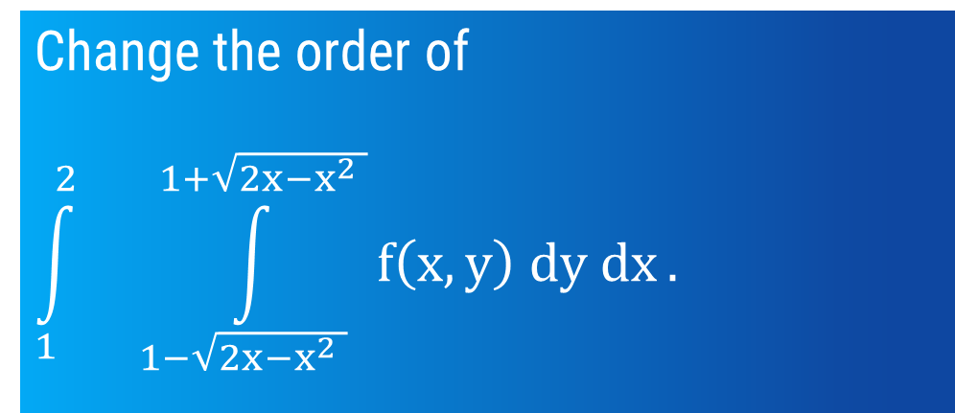
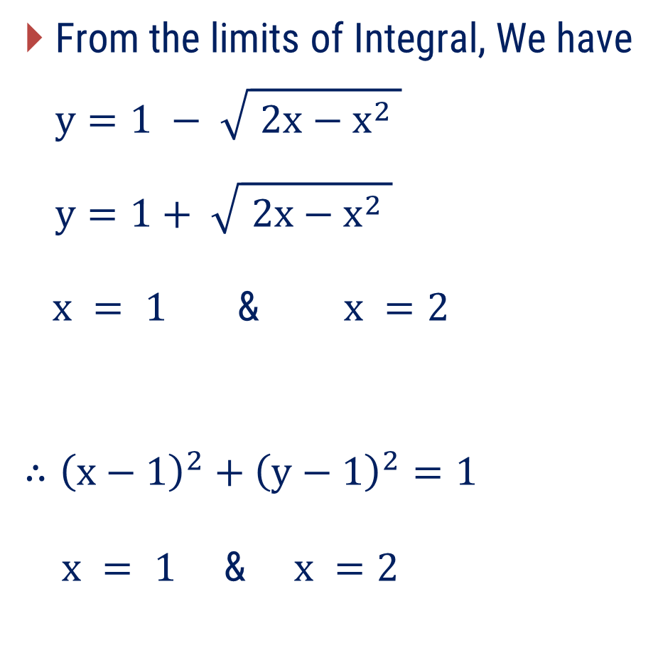
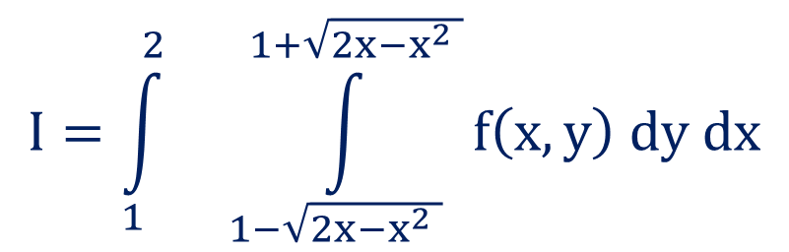
Method 5 $⇒$ Example – 4
Change the order of
$$\int_{1}^{2}{ \int_{1−\sqrt{2x−x^{2} }}^{1+\sqrt{2x−x^{2} }}{f\left(x, y\right) dy dx}}.$$
Draw the region from given data i.e. from limits of integrals.
Draw the strip as per given limit of integrals.
Now remove the given strip and draw the new strip perpendicular to old strip.
Find the limit of both integrals from new strip & region.
Calculate the example as the example of double integrals.
From the limits of Integral, We have
$$y=1 − \sqrt{ 2x−x^{2} }$$
$$y=1+ \sqrt{ 2x−x^{2} }$$
$x = 1$ & $x =2$
$$∴{\left(x−1\right)}^{2}+{\left(y−1\right)}^{2}=1$$
$x = 1\text{ \& }x =2$
Solution:
$$I=\int_{1}^{2}{ \int_{1−\sqrt{2x−x^{2} }}^{1+\sqrt{2x−x^{2} }}{f\left(x, y\right) dy dx}}$$

Slide 24
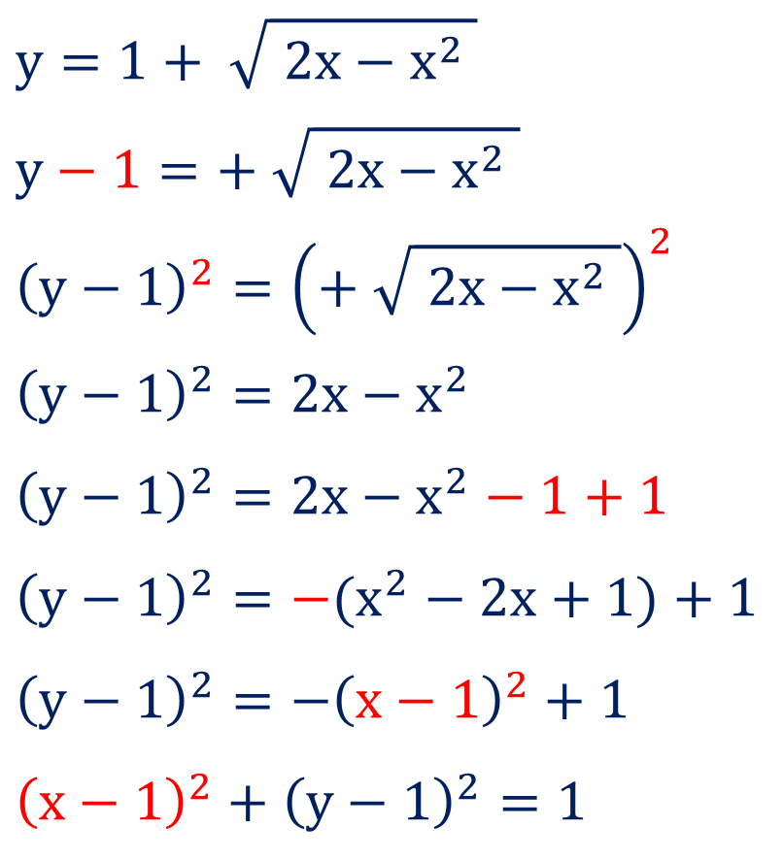
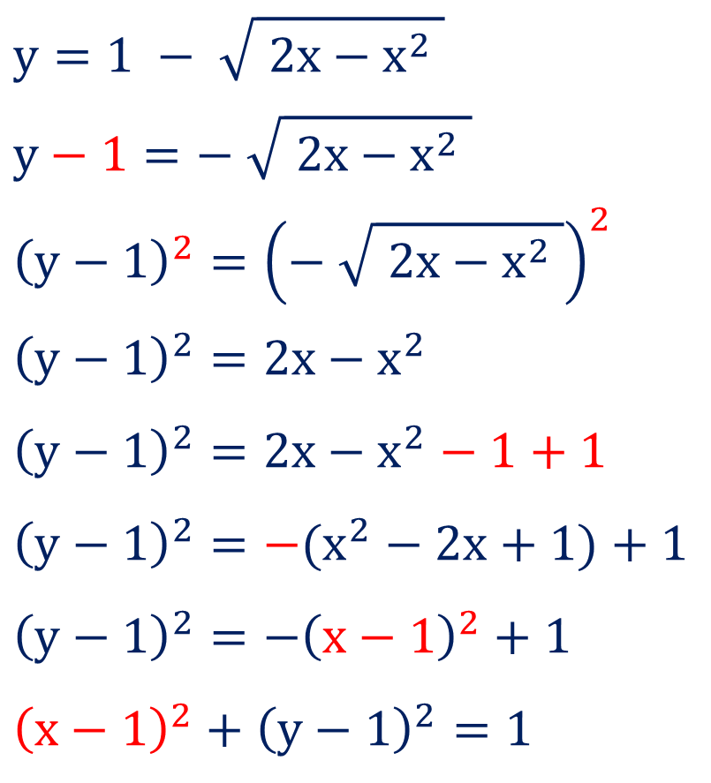
Rough Work
$$y=1 − \sqrt{ 2x−x^{2} }$$
$$y−1=− \sqrt{ 2x−x^{2} }$$
$${\left(y−1\right)}^{2}={\left(− \sqrt{ 2x−x^{2} }\right)}^{2}$$
$${\left(y−1\right)}^{2}=2x−x^{2}$$
$${\left(y−1\right)}^{2}=2x−x^{2}−1+1$$
$${\left(y−1\right)}^{2}=−(x^{2}−2x+1)+1$$
$${\left(y−1\right)}^{2}=−{\left(x−1\right)}^{2}+1$$
$${\left(x−1\right)}^{2}+{\left(y−1\right)}^{2}=1$$
$$y=1+ \sqrt{ 2x−x^{2} }$$
$$y−1=+ \sqrt{ 2x−x^{2} }$$
$${\left(y−1\right)}^{2}={\left(+ \sqrt{ 2x−x^{2} }\right)}^{2}$$
$${\left(y−1\right)}^{2}=2x−x^{2}$$
$${\left(y−1\right)}^{2}=2x−x^{2}−1+1$$
$${\left(y−1\right)}^{2}=−(x^{2}−2x+1)+1$$
$${\left(y−1\right)}^{2}=−{\left(x−1\right)}^{2}+1$$
$${\left(x−1\right)}^{2}+{\left(y−1\right)}^{2}=1$$

Slide 25
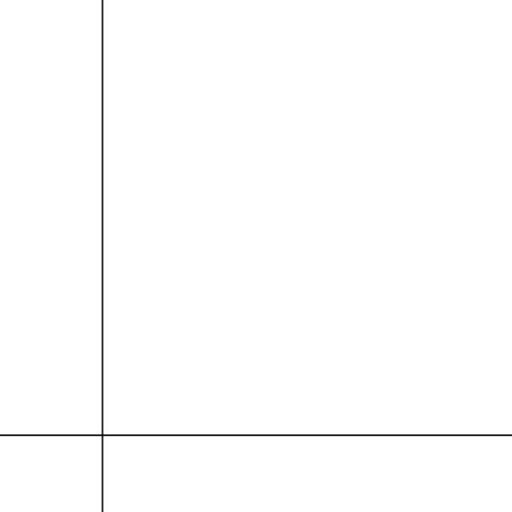
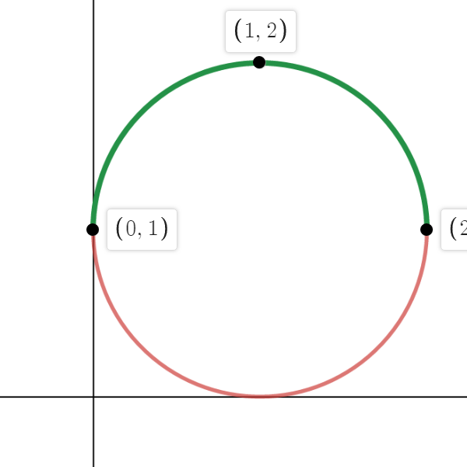
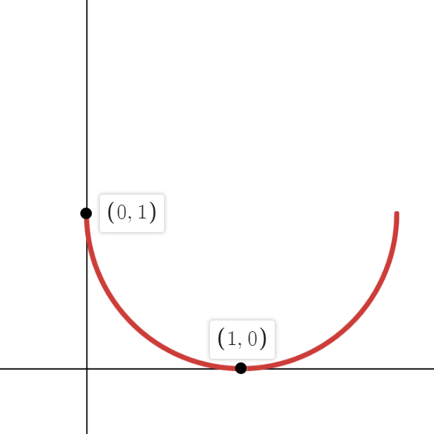
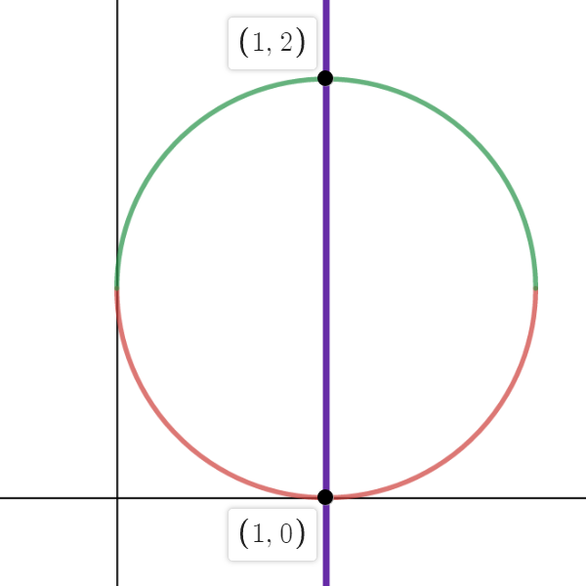
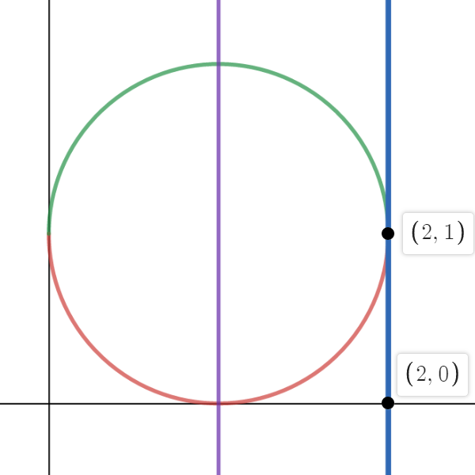
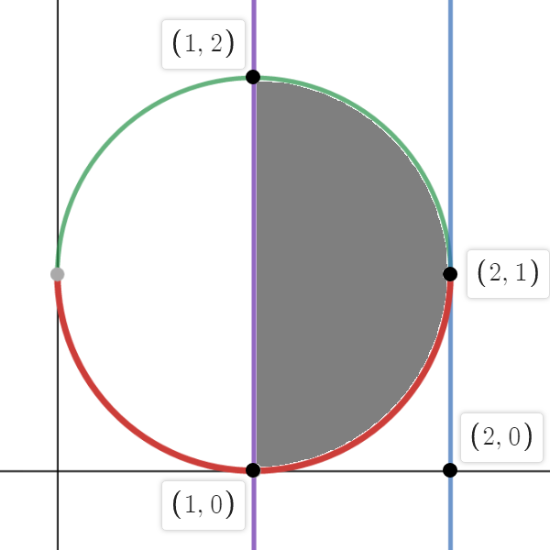
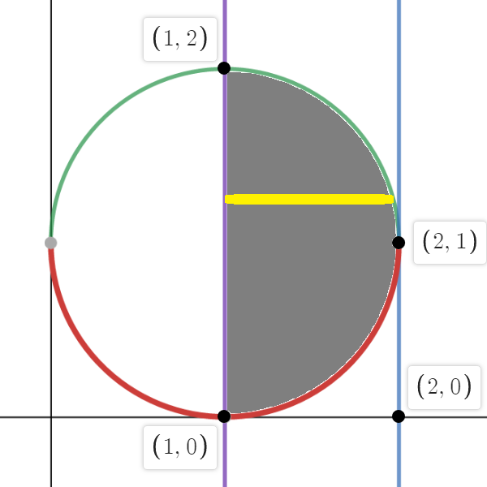
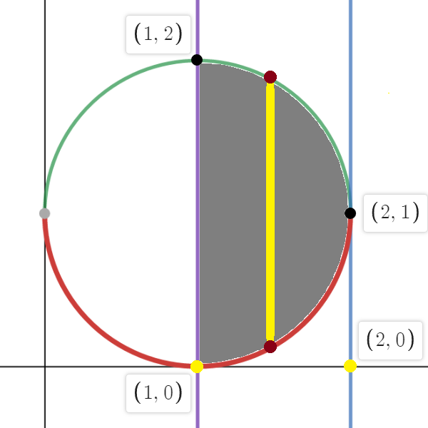
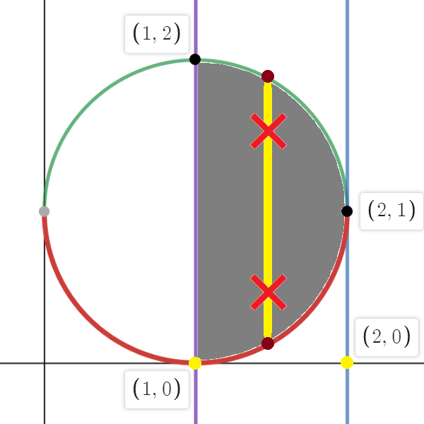
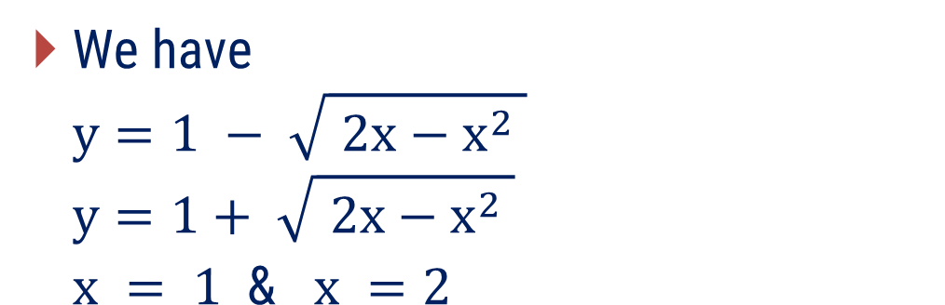


Method 5 $⇒$ Example – 4(continue)
We have
$$y=1 − \sqrt{ 2x−x^{2} }$$
$$y=1+ \sqrt{ 2x−x^{2} }$$
$$x = 1 \text{ \&} x =2$$
$$∴I=\int_{1}^{2}{ \int_{1−\sqrt{2x−x^{2} }}^{1+\sqrt{2x−x^{2} }}{f\left(x, y\right) dy dx}}$$
$$∴I=\int_{y=0}^{2}{ \int_{x=1}^{1+\sqrt{2y−y^{2} }}{f\left(x, y\right) dx dy}}$$

Slide 26



Method 5 $⇒$ Example – 7
$$Evaluate \int_{0}^{3}{ \int_{\sqrt{\frac{ x }{ 3 }}}^{1}{e^{y^{3}} dy dx.}}$$
From the limits of Integral, We have
$$y=\sqrt{ \frac{ x }{ 3 } }$$
$$y=1$$
$x =0$ & $x =3$
$∴x=3y^{2}$ & $y =1$
$x =0$ & $x =3$
Solution: S-19 (7mark)
$$I=\int_{0}^{3}{ \int_{\sqrt{\frac{ x }{ 3 }}}^{1}{e^{y^{3}} dy dx}}$$

Slide 27












Method 5 $⇒$ Example – 7(continue)
We have
$y=\sqrt{ x/3 }$ & $y =1$
$x = \text{0}$ & $x =3$
$$∴I=\int_{0}^{3}{ \int_{\sqrt{\frac{ x }{ 3 }}}^{1}{e^{y^{3}} dy dx}}$$
$$∴I=\int_{0}^{1}{ \int_{x=0}^{3y^{2}}{e^{y^{3}} dx dy}}$$
……

Slide 28



Method 5 $⇒$ Example – 12
Change the order of integrations and hence evaluate
$$\int_{0}^{1}{ \int_{0}^{\sqrt{1−x^{2 }}}{\frac{e^{y}}{ \left(e^{y}+1\right)\sqrt{1−x^{2}−y^{2} }}dy dx.}}$$
From the limits of Integral, We have
$$y=\sqrt{1−x^{2 }}$$
$$y=0$$
$x =0$ & $x =1$
$∴x^{2}+y^{2}=1$ & $y =0$
$x =0$ & $x =1$
Solution:
$$I=\int_{0}^{1}{\int_{0}^{\sqrt{1−x^{2 }}}{\frac{e^{y}}{ \left(e^{y}+1\right)\sqrt{1−x^{2}−y^{2} }}dy dx}}$$

Slide 29












Method 5 $⇒$ Example – 12(continue)
We have
$y=\sqrt{1−x^{2 }}$ & $y =0$
$x = \text{0}$ & $x =1$
$$∴I=\int_{0}^{1}{\int_{0}^{\sqrt{1−x^{2 }}}{ ??? dy dx}}$$
$$∴I=\int_{0}^{1}{ \int_{x=0}^{\sqrt{1−y^{2 }}}{\frac{e^{y}}{ \left(e^{y}+1\right)\sqrt{1−x^{2}−y^{2} }} dx dy}}$$
……

Slide 30



Method 5 $⇒$ Example – 17
Change the order of integration and evaluate
$$\int_{0}^{4}{ \int_{\frac{x^{2}}{4}}^{2\sqrt{x}}{dy dx}}.$$
From the limits of Integral, We have
$$y=\frac{ x^{2} }{4} \& y=2\sqrt{x}$$
$x =0$ & $x =4$
$$∴x^{2}=\text{4}\text{y}, y^{2}=4x$$
$x =0$ & $x =4$
Solution:
$$I=\int_{0}^{4}{ \int_{\frac{x^{2}}{4}}^{2\sqrt{x}}{dy dx}}$$

Slide 31















Method 5 $⇒$ Example – 17(continue)
We have
$y=x^{2}/4 \& y=2\sqrt{x}$
$x =0$ & $x =4$
$$y=\frac{ x^{2} }{4}$$
$$∴I=\int_{0}^{4}{ \int_{x^{2}/4}^{2\sqrt{x}}{1 dy dx}}$$
$$∴I=\int_{0}^{4}{ \int_{x = y^{2}/4}^{2\sqrt{y}}{1 dx dy}}$$
$$y=2\sqrt{x}$$
……

Slide 32


Method 5 $⇒$ Example – 19
Express as single integral and hence evaluate
$$\int_{0}^{1}{\int_{0}^{y}{\left(x^{2}+y^{2}\right) dx dy}}+\int_{1}^{2}{ \int_{0}^{2−y}{\left(x^{2}+y^{2}\right) dx dy}}$$
Solution:
From the limits of 1st Integral, We have
$x=0, x=y$ & $y=0, y=1.$
From the limits of 2nd Integral, We have
$x=0, x=2−y$ & $y=1, y=2.$

Slide 33














Method 5 $⇒$ Example – 19(continue)
We have
$$x=0, x=y,$$
$$y=0, y=1$$
&
$$x=0, x=2−y$$
$y=1, y=2$
$$\int_{0}^{1}{\int_{0}^{y}{\left(x^{2}+y^{2}\right) dx dy}}$$
$$\int_{1}^{2}{ \int_{0}^{2−y}{\left(x^{2}+y^{2}\right) dx dy}}$$

Slide 34






Method 5 $⇒$ Example – 19(continue)
$$I=\int_{0}^{1}{\int_{0}^{y}{\left(x^{2}+y^{2}\right) dx dy}}$$
$$+\int_{1}^{2}{ \int_{0}^{2−y}{\left(x^{2}+y^{2}\right) dx dy}}$$
$$x=2−y$$
$$∴I=\int_{0}^{1}{ \int_{y = x}^{2−x}{\left(x^{2}+y^{2}\right) dy dx}}$$
$$x=y$$
……

Slide 35


